Slide 1
Managing Project and Teams
Lecture 12: Etthics & Emerging Trends in Managing Projects and Teams

Slide 2
Key topics covered in this lecture

Slide 3
What we will cover in this lecture
By the end of the lesson, students should be able to:
Defining ethics, ethical behaviour
Identify emerging trends in managing projects
Explain Kohlberg’s levels of individual moral development
Discuss ethics in the Workplace
Identify emerging trends in managing projects and teams

Slide 4
Ethics
Ethics
Moral code of principles.
Set standards of “good” or “bad” or “right” or “wrong” in one’s conduct.
Ethical behavior
What is accepted as good and right in the context of the governing moral code.
Morals or doctrine of conduct relating to, dealing with, or capable of making the distinction between right and wrong in conduct or character.
Being Ethical is
Conforming to Moral Standards; conforming to the standards of conduct of a given group or profession.

Slide 5
Ethics
Any behaviour considered Ethical should also be legal in a just and fair society.
Laws and values as influences on ethical behavior:
Legal behavior is not necessarily ethical behavior.
Personal values help determine individual ethical behavior.

Slide 6
Ethics in the Workplace
Ethical dilemmas
occur when choices, although having potential for personal and/or organizational benefit, may be considered unethical.
Ethical dilemmas common examples include:
Discrimination
Sexual harassment
Conflicts of interest
Product safety
Use of organizational resources
Notes:
Ethical Dilemmas • An ethical dilemma occurs when someone must decide whether or not to pursue a course of action that, although offering the potential of personal or organizational benefit or both, may be considered potentially unethical.
Most ethical dilemmas involve conflicts with superiors, customers, and subordinates.

Slide 7
Case Study
Imagine a E-commerce giant scaling their platform where the project manager, in an effort to meet tight deadlines and budget constraints, decides to subcontract certain tasks to a software house known for exploiting labour in order to provide cheaper services. While it may be legal to engage with this supplier and their labour practices might not violate any laws, it raises ethical concerns regarding fair labour practices and human rights.
Comment on the basis of ethics/ethical behaviour

Slide 8
Ethics
Four alternative ethical views
Utilitarian
Delivers the greatest good to the most people
Individualism
Advances long-term self-interests
Moral rights
Respects and protects the fundamental rights of all people
Justice
Fair and impartial treatment of people according to legal rules and standards
Procedural justice – policies and rules fairly applied
Distributive justice – fair distribution of outcomes
Interactional justice – people treated with dignity and respect
Commutative justice – fairness to all involved

Slide 9
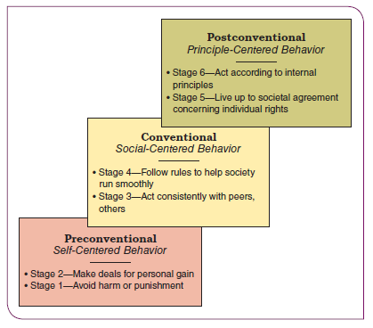
Kohlberg’s levels of individual moral development
Notes:
Lawrence Kohlberg's theory of moral development outlines six stages of moral reasoning, grouped into three levels.

Slide 10
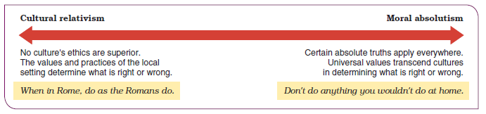
Cultural relativism and ethical imperialism in ethics

Slide 11
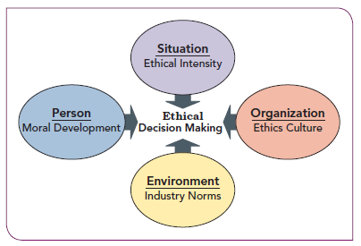
Ethics in the Workplace
Influences on Ethical Decision Making
Ethical framework
Provides personal rules or strategies for ethical decision making
Includes personal values
Honesty
Courage
Fairness
Integrity
Self-respect
Notes:
Ethics intensity or issue intensity
the extent to which situations are perceived to pose important ethics challenges
Organization Setting
The work and social settings of organizations have a strong influence on the ethics of members
External Environment, Government Regulation, and Industry Norms
Laws reflect social values and define appropriate behavior; regulations help governments monitor these behaviors and keep them within acceptable limits

Slide 12
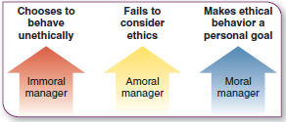
Maintaining High Ethical Standards
Moral Management
Project Managers behave in one of three ways

Slide 13
How can mantain High Ethical Standards

Slide 14
Code of Ethics
Organisational citizenship
Illegal or improper acts
Customer/coworker relationships
Bribes and Kickbacks
Political contributions
Honest of books
Whistleblowers
Social responsibility (Profit,People,Planet)

Slide 15
Emerging trends in managing project &teams
Artificial Intelligence and Automation
Advanced Resource and Project Management Software
Rise in remote
Demand for Emotionally Intelligent Leaders
Data Analytics for Data-Driven Project Management
Emphasis on soft skills
Notes:
In the realm of software project management, evolution is the only constant.
The way projects are conceived, managed, and executed is experiencing a paradigm shift.
It is important for project managers and team members to adapt to change and monitor emerging trends.

Slide 16
Possible Research Topics

